Slide 1
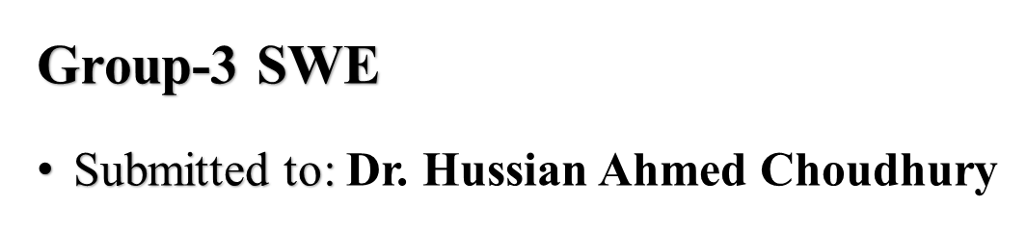

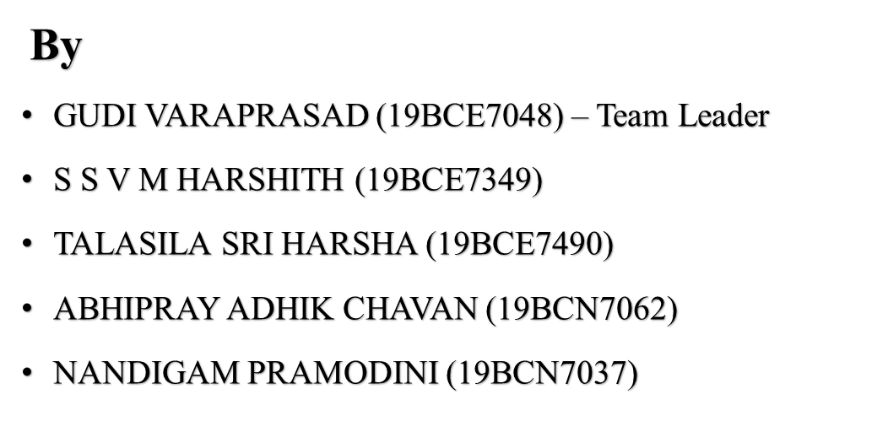
WEB BASED BILLING SOFTWARE

Slide 2
INDEX
INTRODUCTION
PROBLEM STATEMENT
LITERATURE SURVEY
OBJECTIVE
FEASIBILITY STUDY
FUNCTIONAL AND NON FUNCTIONAL REQUIREMENTS
METHODOLOGY AND DESIGN(UML DIAGRAMS)
SAMPLE CODE AND OUTPUTS
TESTING
FUTURE SCOPE
REFERENCE

Slide 3
INTRODUCTION
This project “Web based Billing Software” is an application to automate the process of billing and managing a Departmental store.
This web-based application is considered based on a network of department stores with locations around the country.
PROBLEM STATEMENT
Easiness in maintaining and modification of sold products.
Reports are simple to implement, create, generate within no time.
No or very few paperwork.

Slide 4
LITERATURE SURVEY
Understand the Root Causes: Existing systems include a lot of paperwork and require a lot of manual labor; this may be remedied by automating the process with a web-based GUI.
Identify the Stakeholder and Users: Stakeholders - admin, developers, target audience, funders, clients. Users - Businessmen, Enterprises, Shopkeepers, Vendors, Govt., officers.
Identifying the constraints to be imposed on the solution: a. Customers without Internet Access. b. Information Privacy. c. not cost-effective for small scale business owners

Slide 5
OBJECTIVE
Generating and Managing Bills in a matter of few seconds.
Maintain all the products with their shorthand notation.
Provides summary reports to the owner between any dates.
Provides a convenient solution to the billing pattern.
Make an easy-to-use environment for owners and customers.
Secured User Authentication and Validation.
User Giveaway generator.

Slide 6
FEASIBILITY STUDY
S.No | Feasibility Analysis | Type | Feasibility ?
1. | Technical Feasibility | Software, Hardware, OS | Yes
2. | Behavioural Feasibility | Computer, User Knowledge | Yes
3. | Economic Feasibility | Manpower cost, Hardware / Software cost | Yes
4. | Timeline | Duration of 8 days approximately | Yes

Slide 7
FUNCTIONAL REQUIREMENTS
This section gives a high-level summary of the system’s requirements. The system will be able to implement a variety of functional modules, including: Description: The key consideration involved in functional requirements are the needs that the end user expresses as essential features that the software should provide. Signup / Registration: If a client wishes to create or manage, download, or print a bill, he or she must first register. Unregistered users are unable to do the above tasks.
Login: The user logs in to the online application using a valid user id and password that has been successfully validated in order to manage bills.

Slide 8
Bill Generation: Every logged-in user will be able to create and generate bills, as well as store current bills, print, and download those generated bills and reports.
Product shorthand notations: Every product has a shorthand representation of the entire product label. These shorthand notations can be found on user bills, and users can search for them. Logout: Users can logout after doing the following required processes, and all session activities will be preserved in the database.
Giveaway Generator: Customers are randomly picked, and lucky dip is generated for random product purchases.

Slide 9
NON FUNCTIONAL REQUIREMENTS
In the insurance to the internet, the following Non-Functional Requirements will be present:
Secure access to a customer's personal information.
Availability 24 hours a day, 7 days a week.
Improved component design to improvise peak performance.
For future expansion, a flexible service-based architecture will be particularly desired.
System properties and limitations are defined by Non-Functional Requirements : Security, Reliability, Maintainability, Portability, Extensibility, Reusability, Compatibility, and Resource Utilization are some of the additional non-functional requirements.

Slide 10
METHOD0LOGY
Anyone who owns a department store and wants to utilize this WEB-BASED BILLING SOFTWARE must first sign up for the application.
The owner can create a bill for current items or add new products using the product shorthand page and other operations after joining up with an authenticated email address and password.
The administrator can monitor and contact the registered department store owners who have registered using this application.
The owner may then generate a bill for a customer by selecting available items, adding quantities, and printing the bill.
The online application will compute the total cost of a bill submitted on a specific
date.

Slide 11
If the customer's information must be altered, the owner can go to the Manage Bills page and amend the information (involving edit, updating, delete details).
Through the Giveaway generator, a giveaway is issued for a random number of consumers for each bill made.
Every bill created is maintained in the database and may be accessed at any time.
The report generating page functions, similarly, generating summary reports to the owner on a monthly, weekly, or yearly basis.
This online application will automate the billing and management of a department shop.
This web-based app is built on a network of department stores located around
the country.

Slide 12
DESIGN PHASE

Slide 13
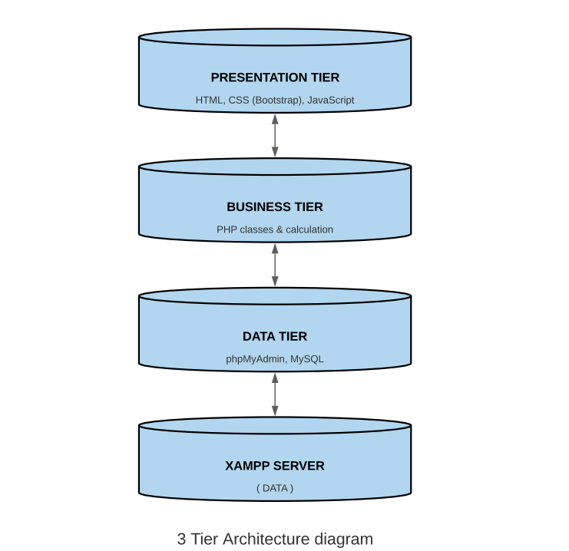
UML
DIAGRAMS

Slide 14
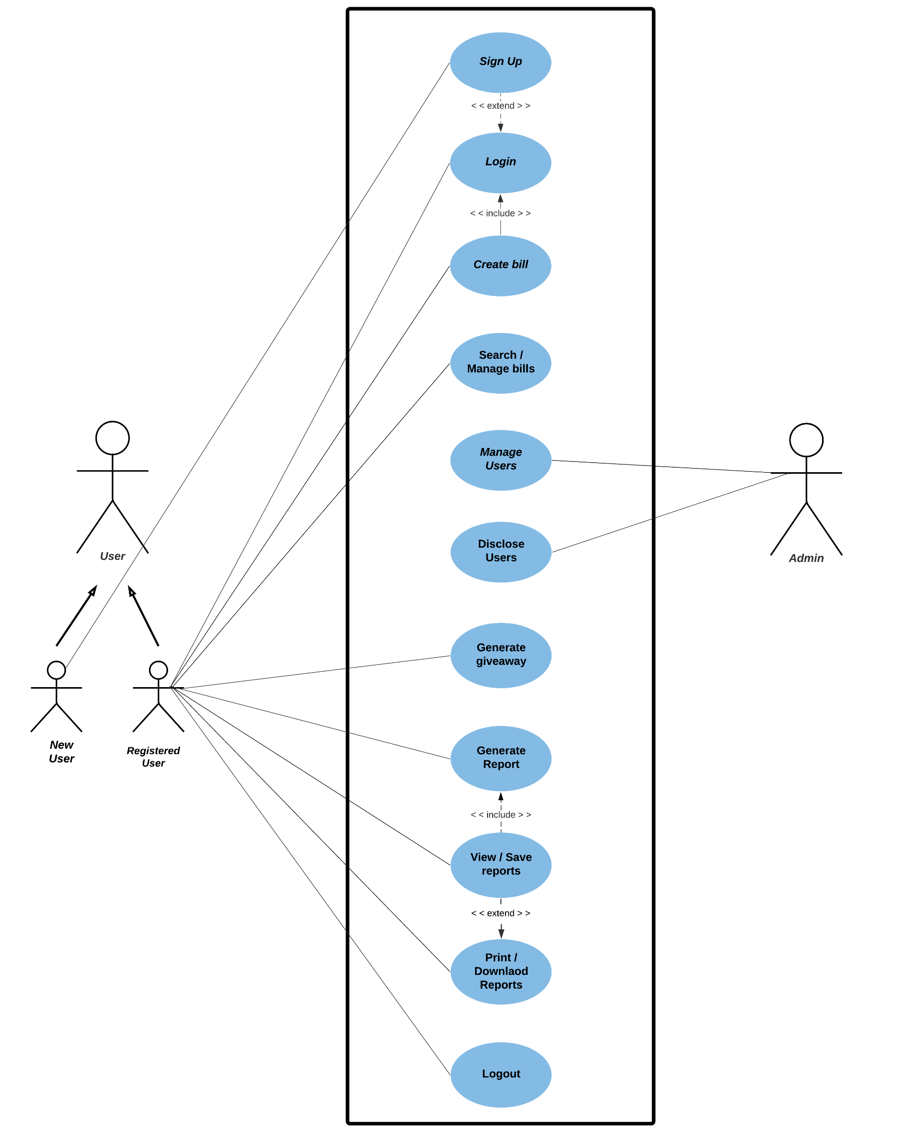
USE-CASE
DIAGRAM

Slide 15
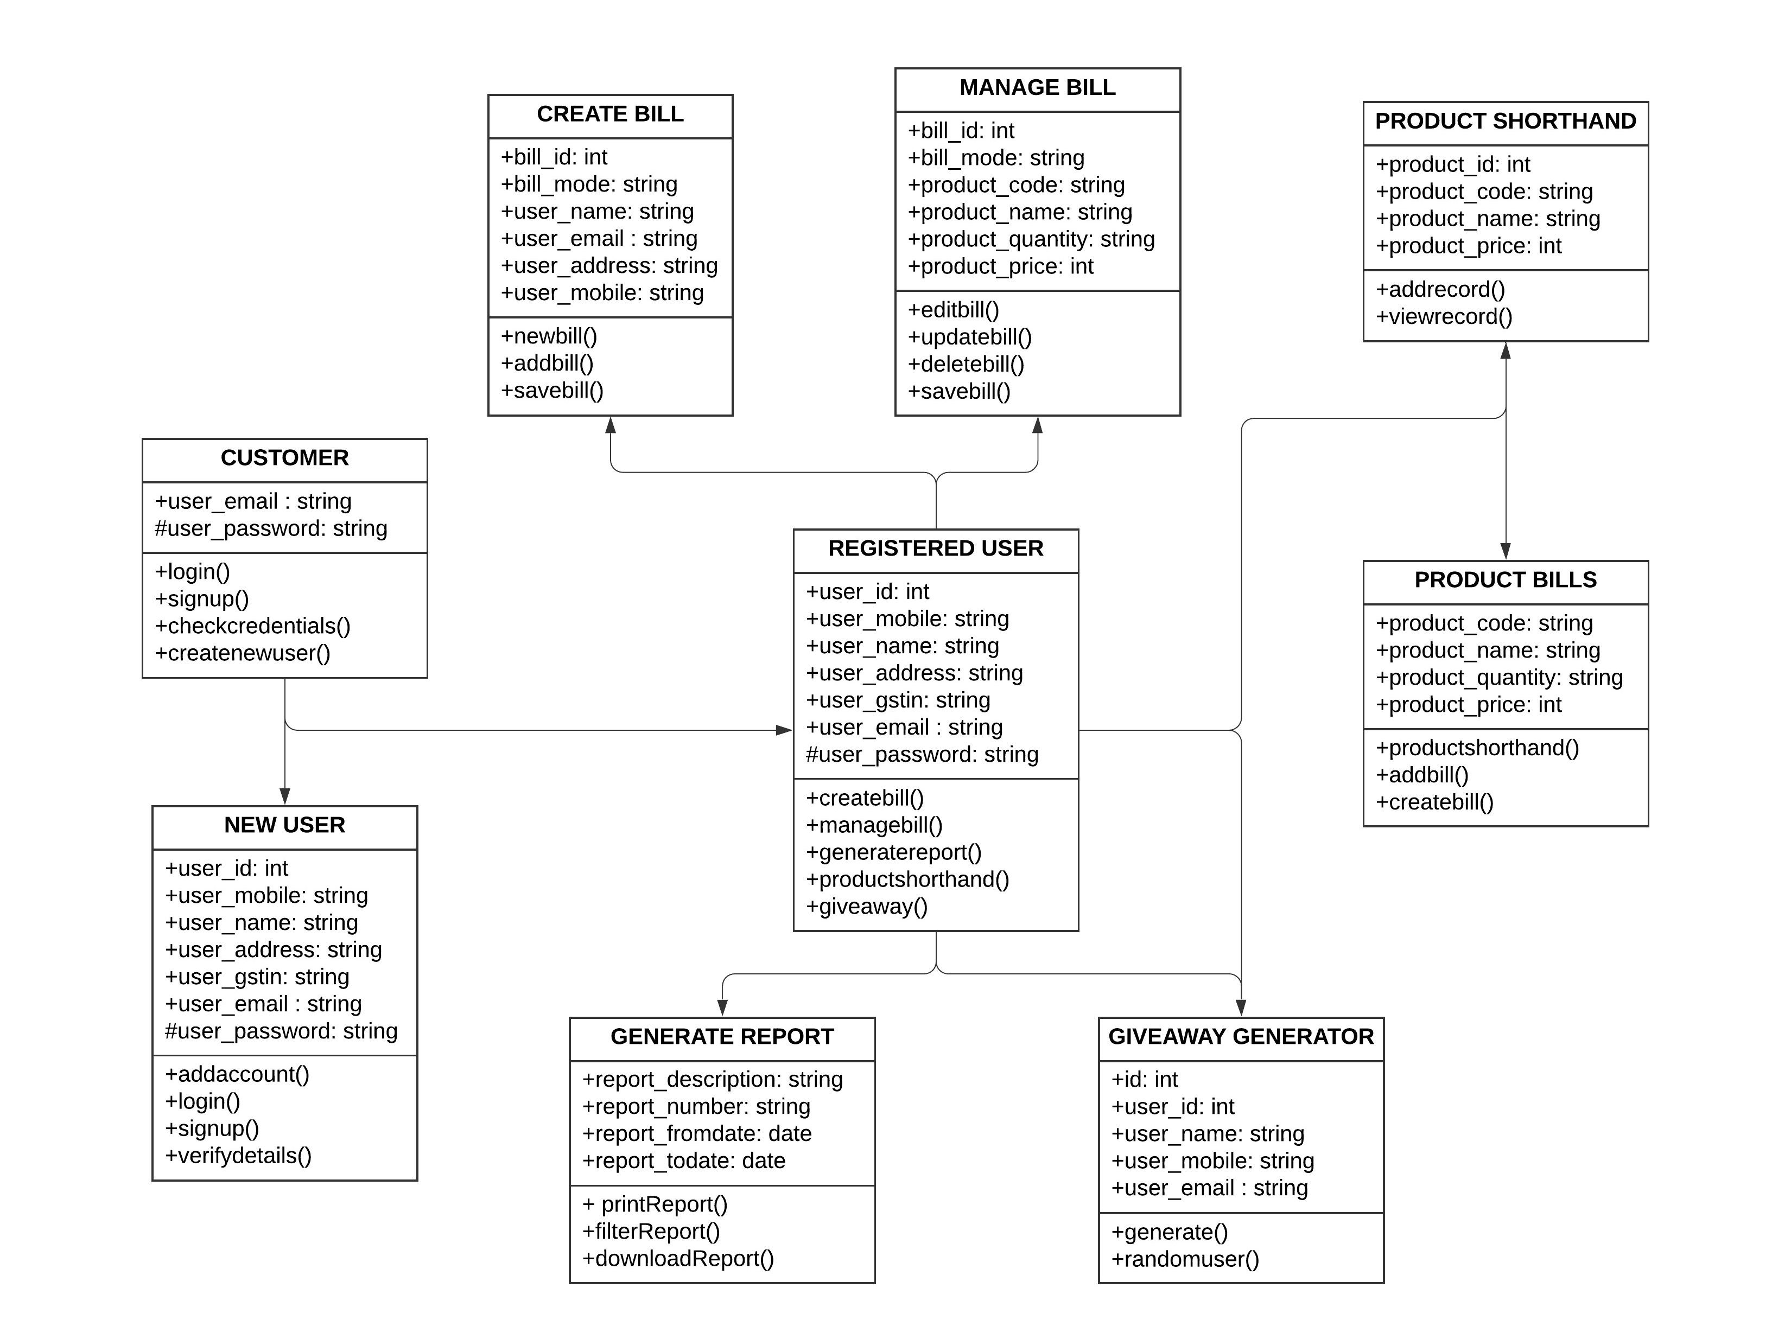
CLASS
DIAGRAM

Slide 16
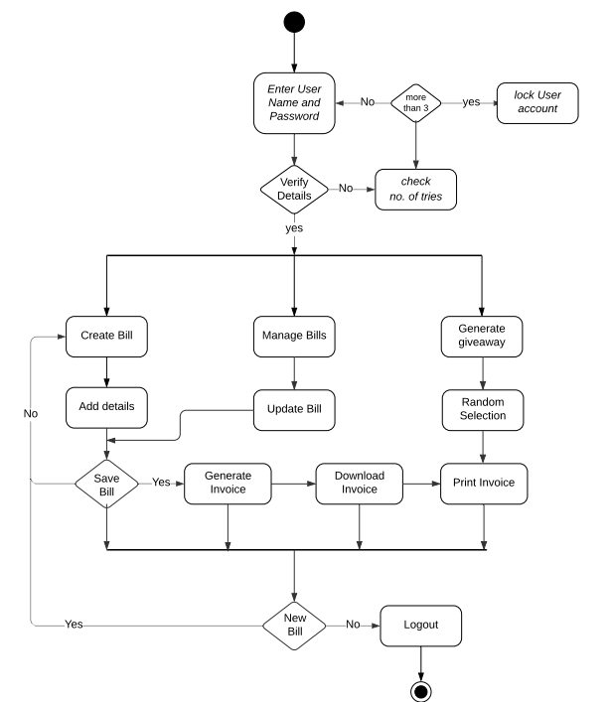
ACTIVITY
DIAGRAM

Slide 17
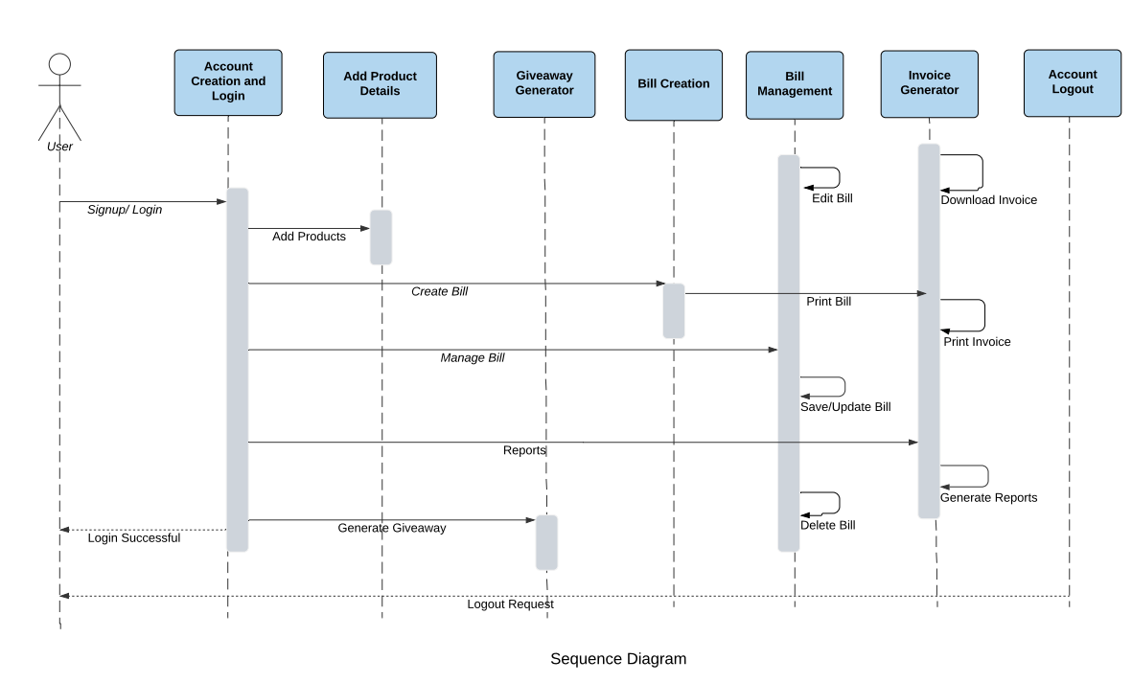

Slide 18
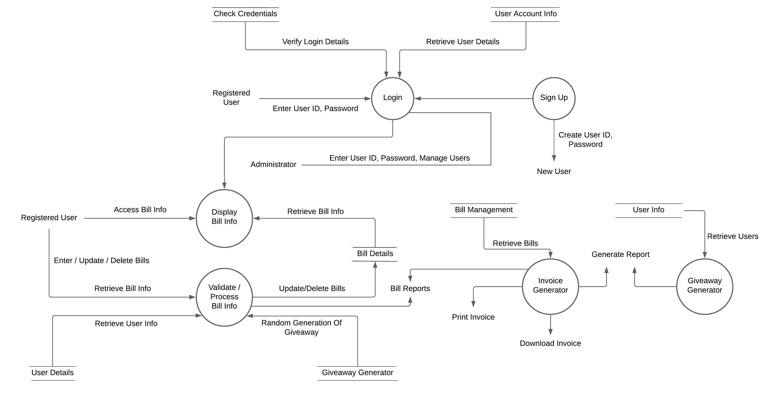
1 Level DFD

Slide 19
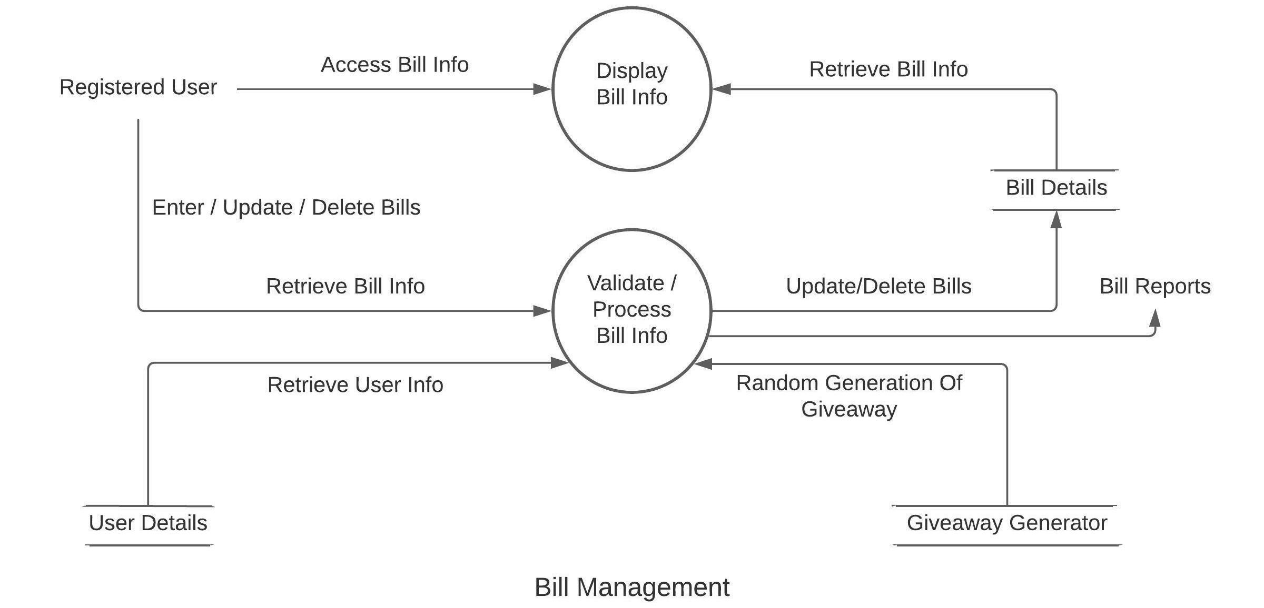
2 Level DFD

Slide 20
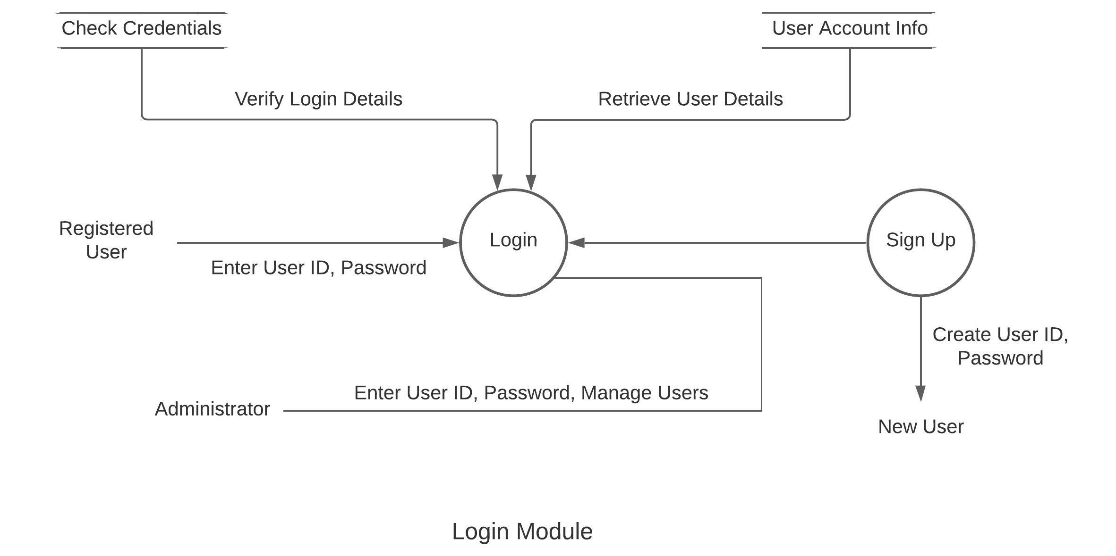
2 Level DFD

Slide 21
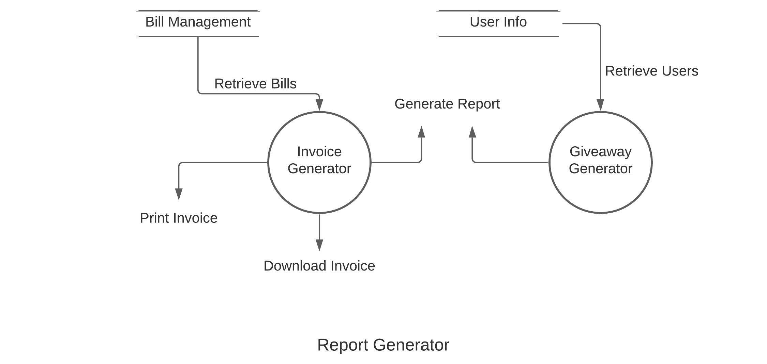
2 Level DFD

Slide 22
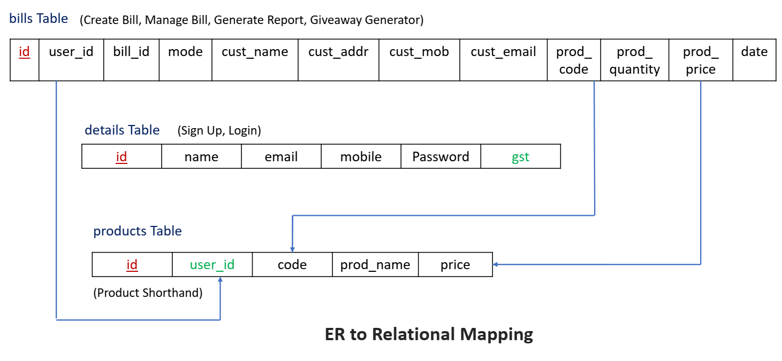
DATABASE DESIGN

Slide 23
SAMPLE CODE

Slide 24
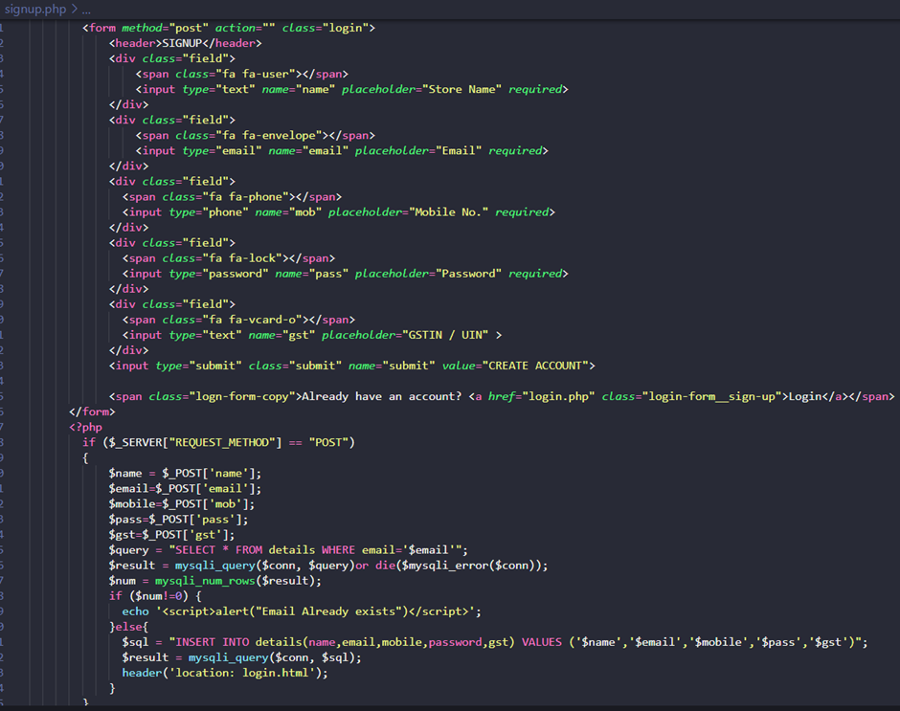
USER
SIGN UP

Slide 25
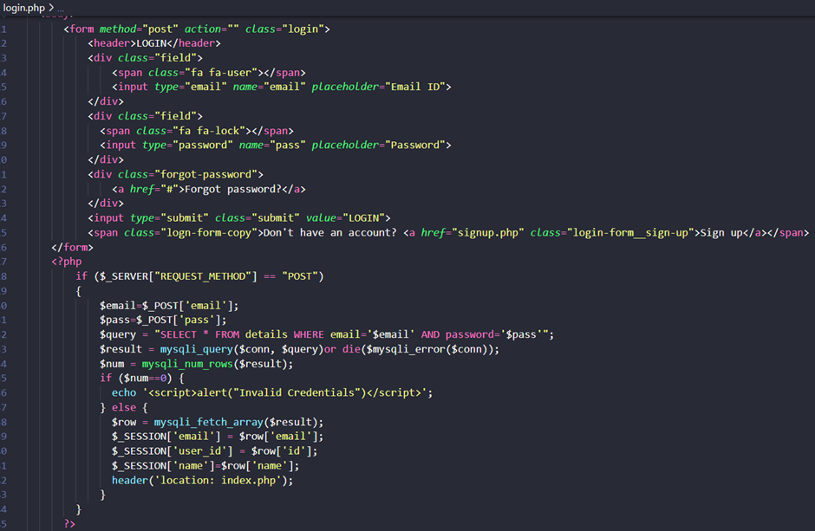
USER
LOGIN

Slide 26
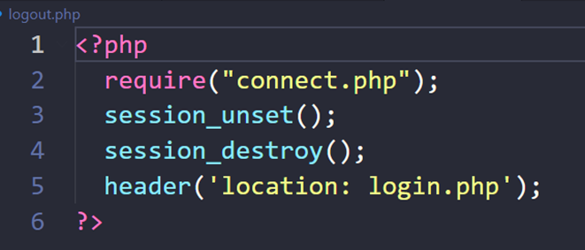
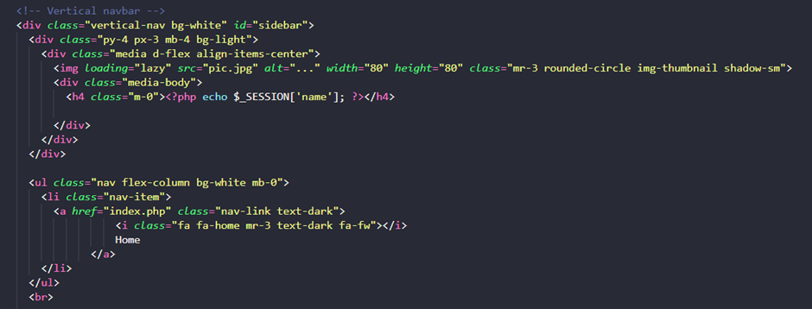
USER
LOGOUT
USER
OPERATIONS

Slide 27
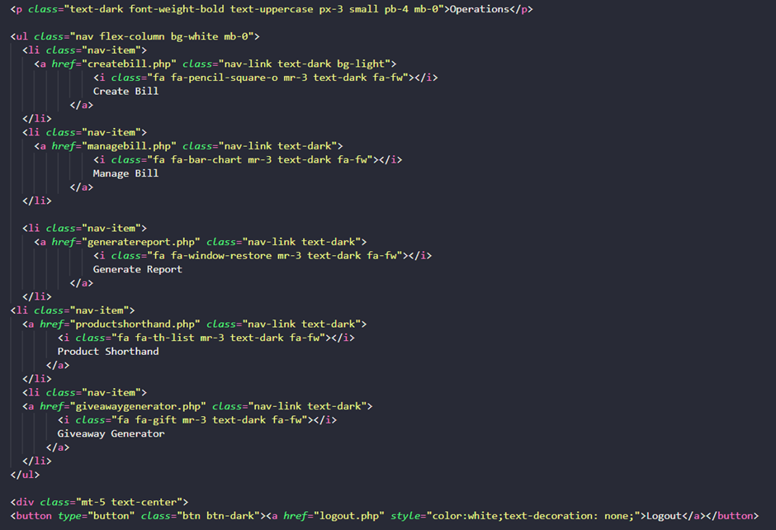
USER
OPERATIONS

Slide 28
CREATE
BILL

Slide 29
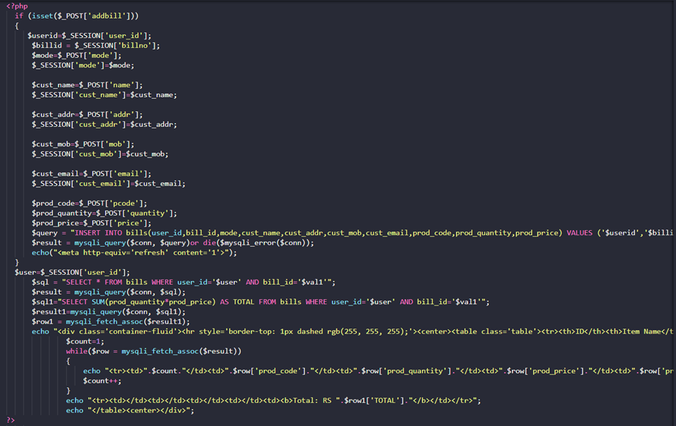
CREATE
BILL

Slide 30
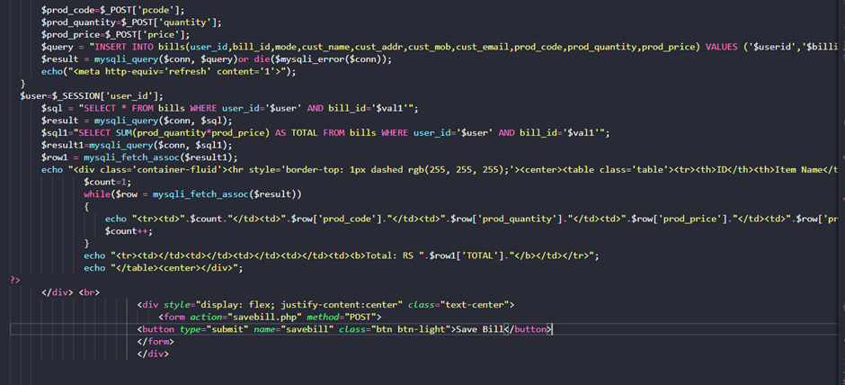
CREATE BILL

Slide 31
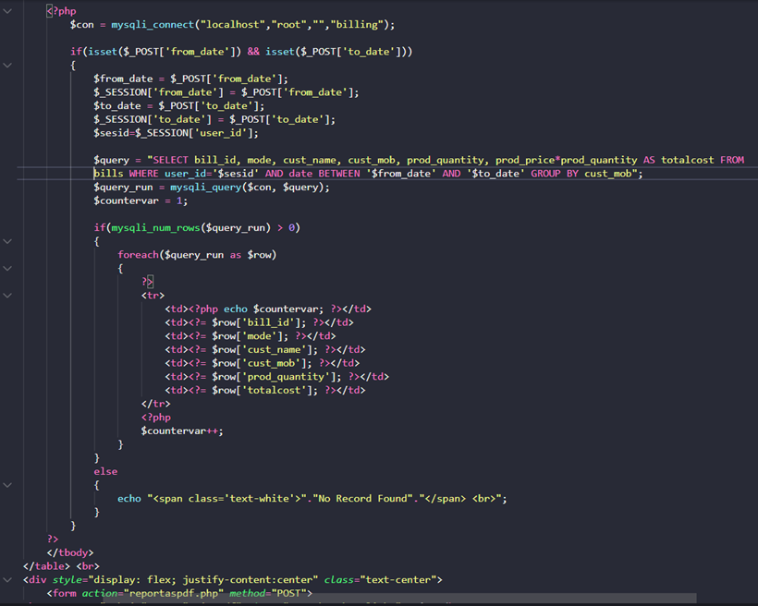
GENERATE
REPORT

Slide 32
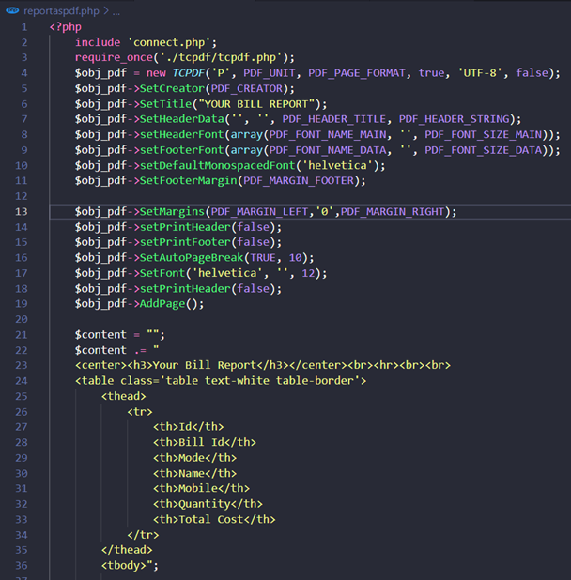
GENERATE
REPORT

Slide 33
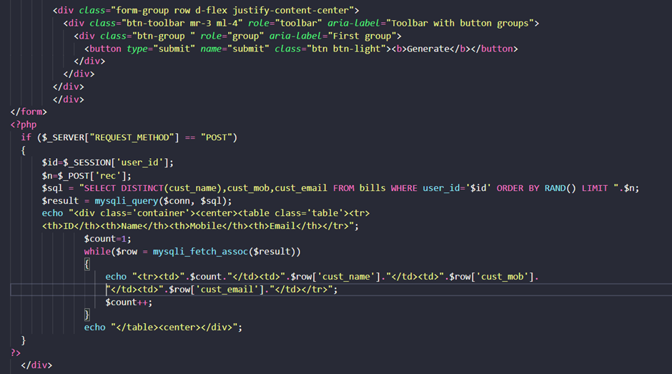
GENERATE
GIVEWAY

Slide 34
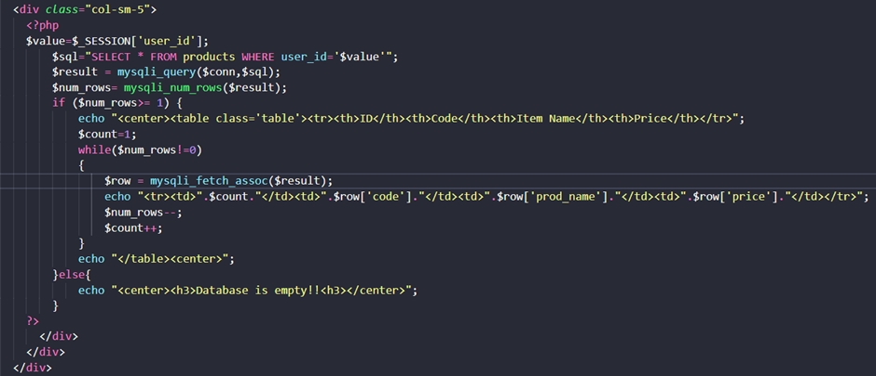
PRODUCT SHORTHAND

Slide 35
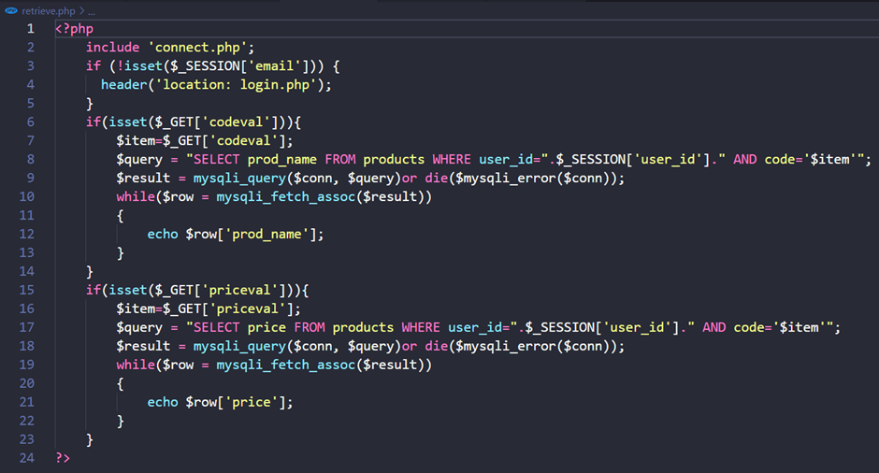
RETRIEVE BILLS

Slide 36
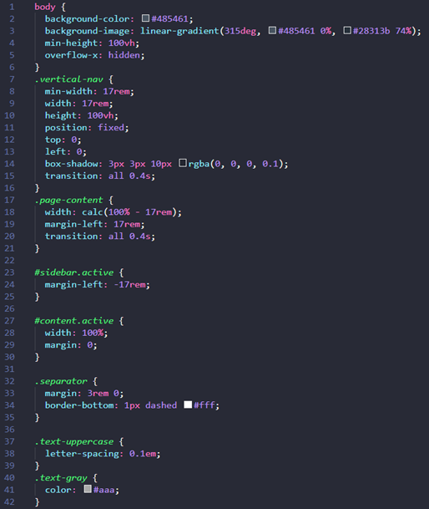
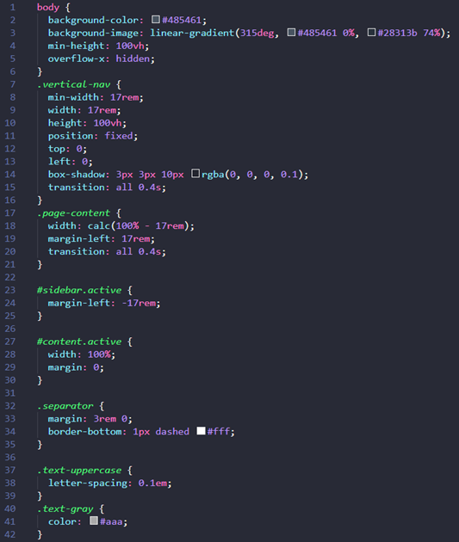
REQUIRED
CSS

Slide 37
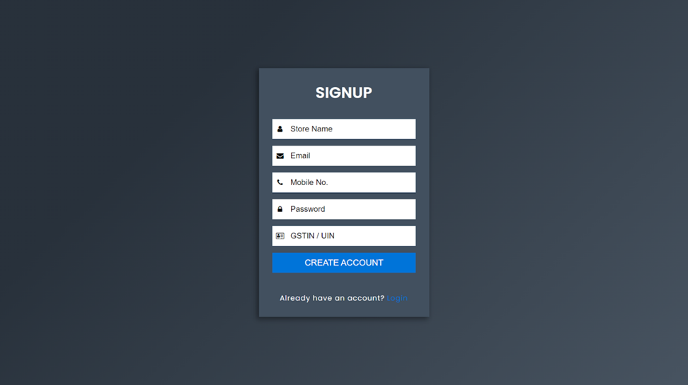
OUTPUT SNAPSHOTS

Slide 38
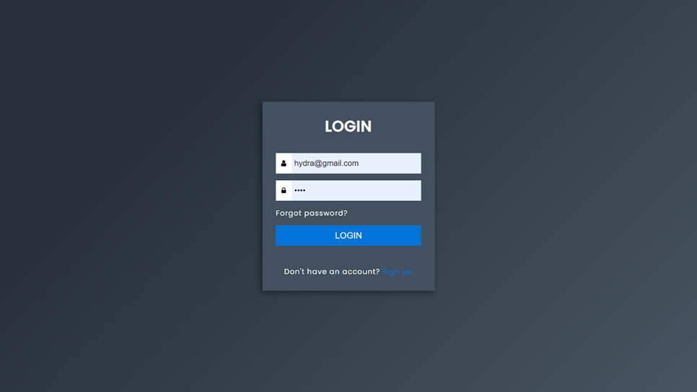

Slide 39
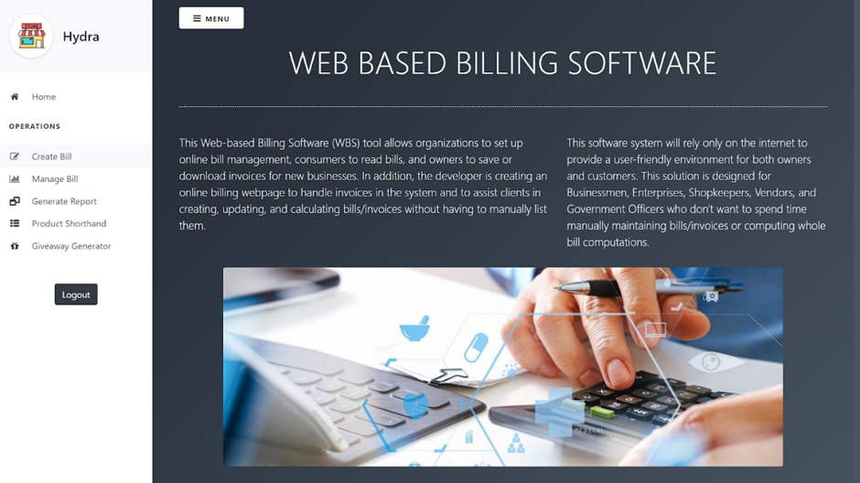

Slide 40
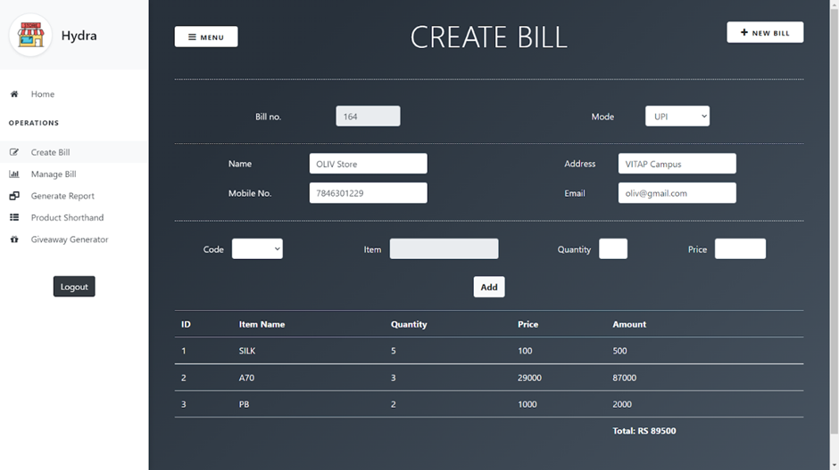

Slide 41
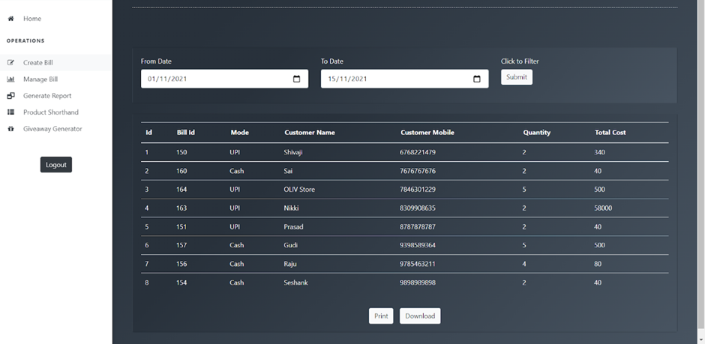

Slide 42
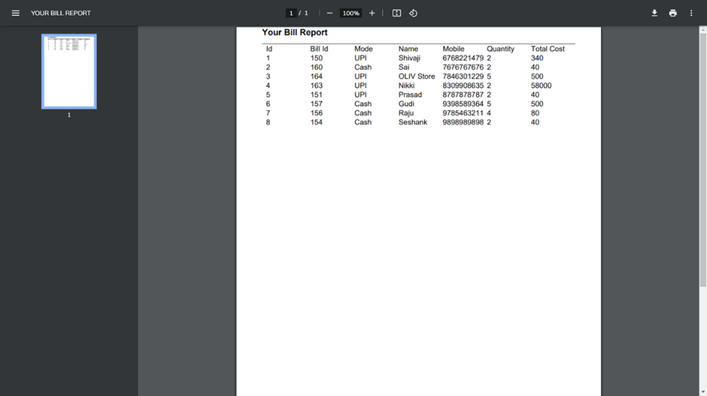

Slide 43
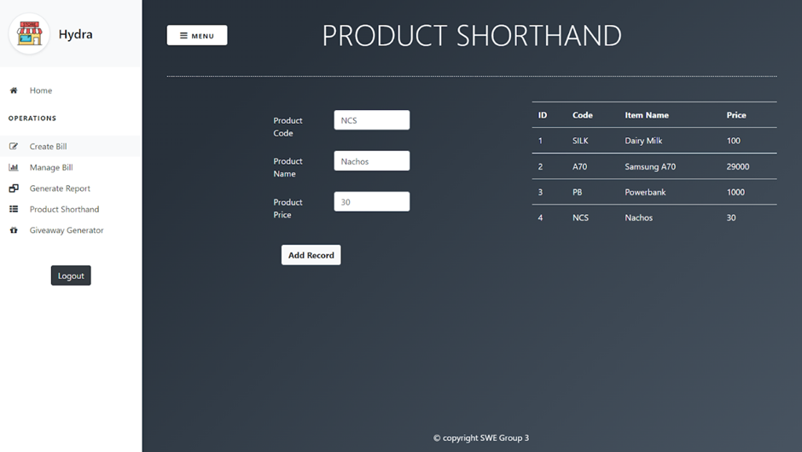

Slide 44
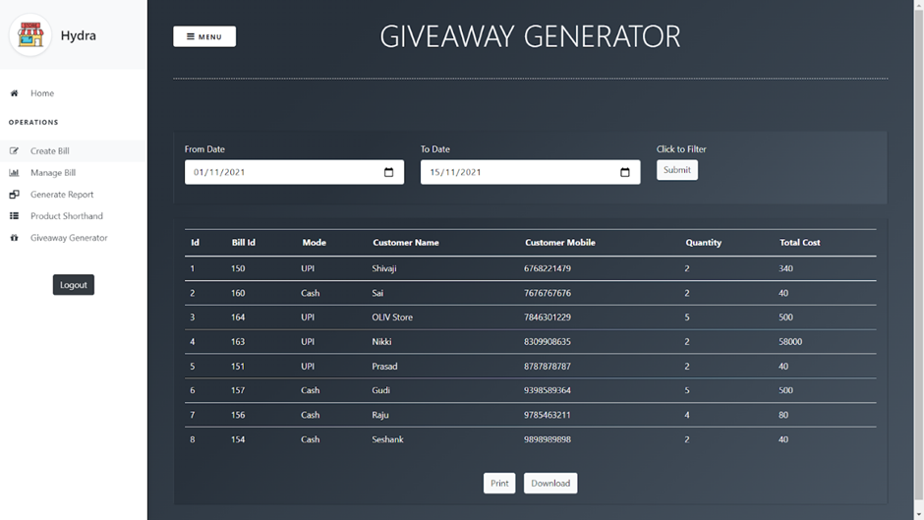

Slide 45
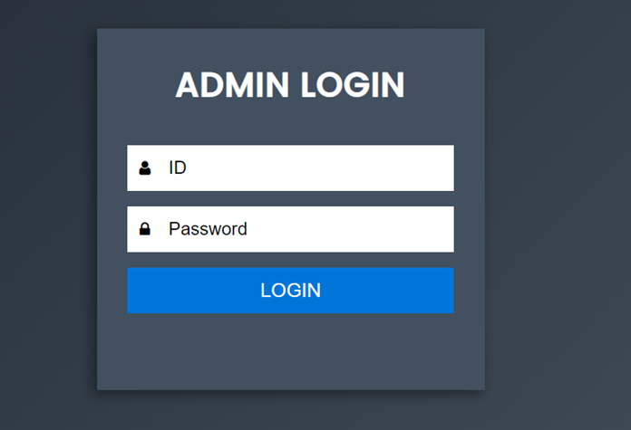

Slide 46
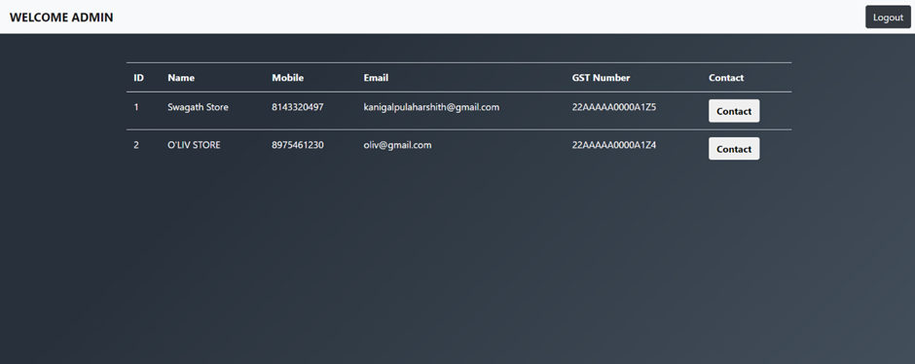

Slide 47
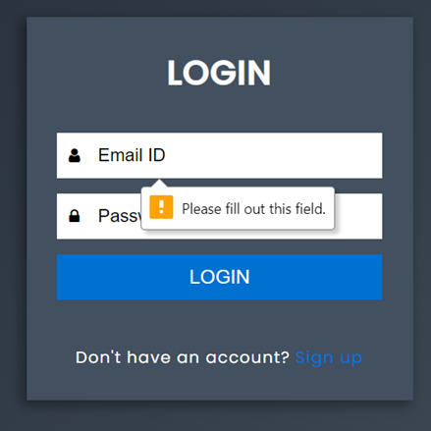
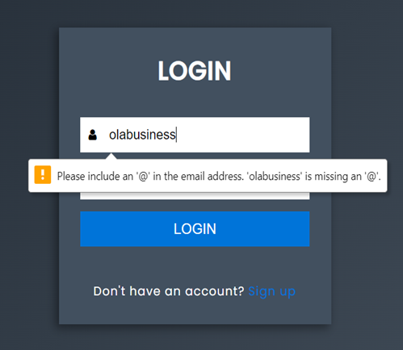
TESTING
1. Testing Login Page, The user credentials are properly validated. Expected output is matched with actual output.

Slide 48
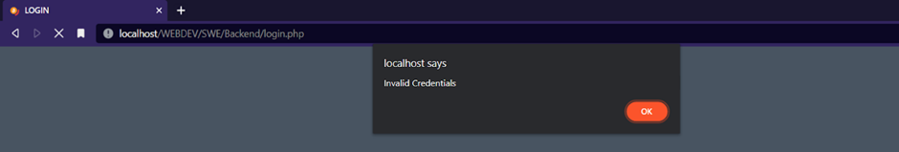
2. When a user credentials and actual credentials don't match, handling the error and displaying with proper error message.

Slide 49
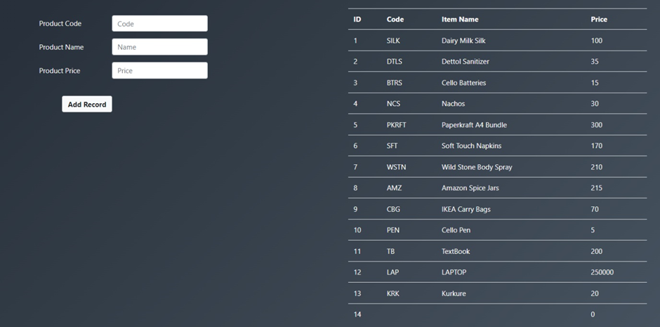
3. When an empty product details are added to the product list, It is not being handled properly. Expected output is not matching with actual output.

Slide 50
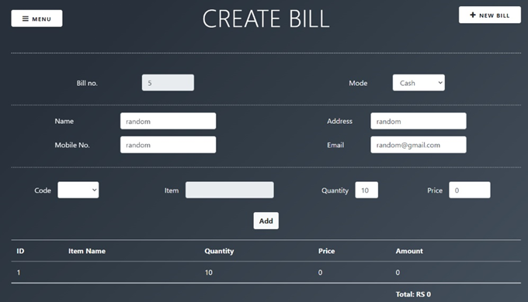
4. Billing for an empty product details. It is not being handled properly. Expected output is not matching with actual output.

Slide 51
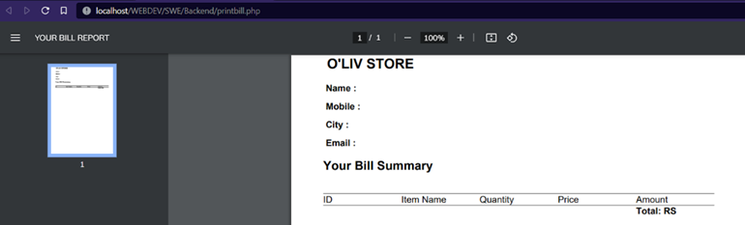
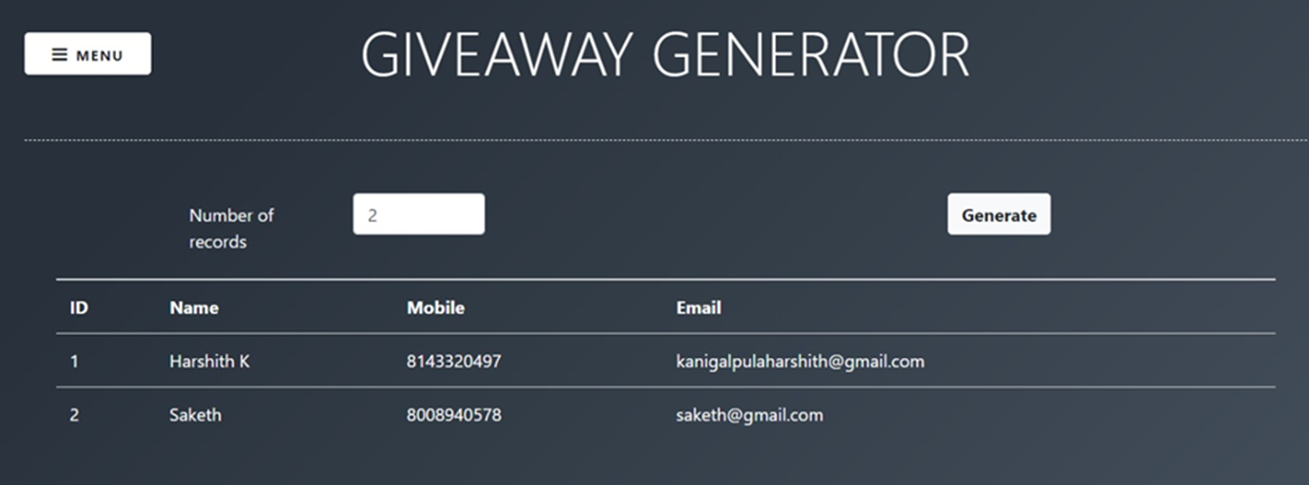
5. The list of random user records that is generated for no. of records is accurate. Expected output matches with actual output.

Slide 52
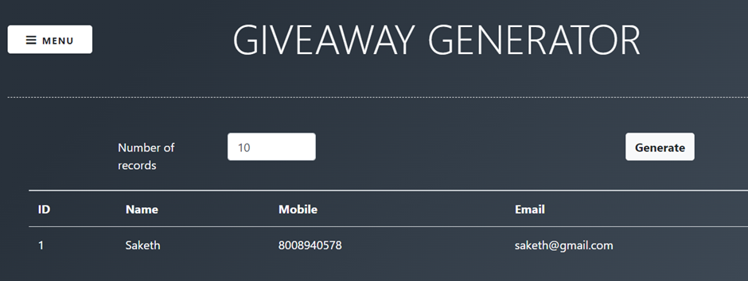
6. The list of random user records that is generated for no. of records entered is not validated. Expected output is not matching with actual output.

Slide 53
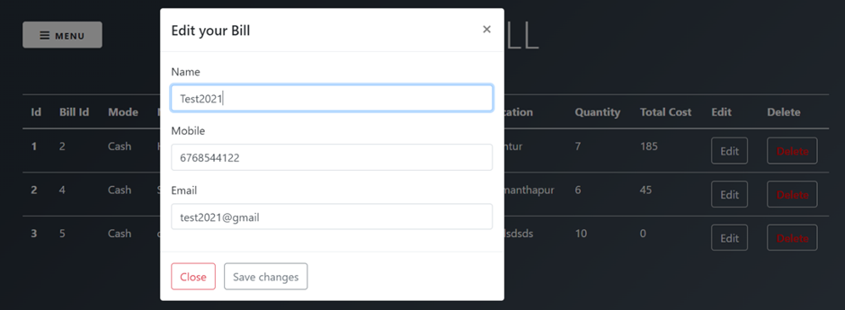
7. A working modal (popup) for Manage bills - Edit button. Expected Output matches with actual output.

Slide 54
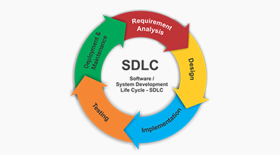
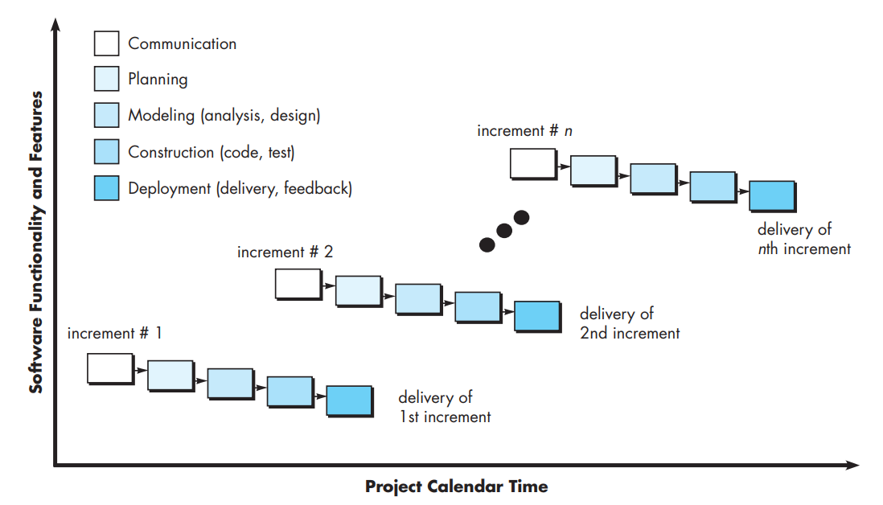
SDLC PHASES
Software Model – INCREMENTAL MODEL
Software Testing – Unit Testing (Black Box)

Slide 55
FUTURE SCOPE
The application is made to keep track of data from a wide range of businesses.
Order confirmation invoices to customer’s devices.
Provides an easy billing pattern solution.
Bill/Invoice creation is instantaneous.
On a regular basis, generates report summaries for the owners.
At times, a user-giveaway feature will be planned with a bill / invoice generation.
REFERENCES
[1] Software Engineering: A Practitioner's Approach by Roger S. Pressman.
[2] Importance of billing software for small businesses.
[3] E-Billing Management System UML Diagram

Slide 56

THANK YOU

